Slide 1

Azure Cloud Migration for Nordbank AB
General Strategy and Pilot Project Description
Notes:
Image requirements: Show example fading in one after the other. I included the PDF that has these examples. Please use examples that are relevant to the topic.

Slide 2
Requirement Specification
The customer is NordBank AB the Swedish subsidiary of a retail bank
Wish to extend their existing data center to the cloud by migrating an internal application to cloud
Have concerns with security of the application in cloud
Have concerns with compliance regulation in cloud
The customer considers this to be a pilot; if the solution is successful, they will consider migrating many more of their applications as well
Pilot project:
The target is an internal business application: .NET, running on 4 servers, each with 4 CPU and 16 Gb of RAM
The application uses a database containing personal data from the bank’s private customers: Oracle, 64Gb of RAM
The servers use a shared disk system with a total of 4 Tb allocated for the servers
RTO requirement for the application is one business day
The application needs to be accessible from the datacenter (batch updates to the database, integration to legacy SSO solution running in the datacenter)
Interested in reducing costs compared to the current datacenter
Notes:
Headcount Increase
Additional resources to our BSA team to shorten lead times and scale when workload increases 8-17
Customer benefit – shorter lead times
Restructuring of team
CSA team will be restructured to be able to pick up tickets quicker – Put them in Zagreb
Added in strong manager to lead the team and join client facing updates
Customer benefit – increased responsiveness from team
Update internal processes
Removed all “non-support” responsibilities from the CSA team to Staffing Best Practices so that CSA team can focus on tickets and issues 5 year olds playing soccer
Putting better system in place for tracking and reporting to set KPI’s for teams
Faster escalation path to management and other teams
Customer benefit – escalations handled quicker, better quality of service, clarity and tracking on tickets
Close knowledge gaps
Created weekly internal learning plan
Knowlegde sharing sessions across teams
External Learning
Customer benefit – Removes risk and challenges of knowledge being restricted to key resources. Reduces wait/ lead times for questions

Slide 3
Migration Roadmap
Step 1: Assess Cloud Readiness
Platform
Data
Connectivity
Security and compliance
Step 2: Plan Azure Migration
Lift and Shift
Application evolution
Application re-architecting
Step 3: Prepare for Cloud Transformation
Step 4: Migrate to Azure
Notes:
Headcount Increase
Additional resources to our BSA team to shorten lead times and scale when workload increases 8-17
Customer benefit – shorter lead times
Restructuring of team
CSA team will be restructured to be able to pick up tickets quicker – Put them in Zagreb
Added in strong manager to lead the team and join client facing updates
Customer benefit – increased responsiveness from team
Update internal processes
Removed all “non-support” responsibilities from the CSA team to Staffing Best Practices so that CSA team can focus on tickets and issues 5 year olds playing soccer
Putting better system in place for tracking and reporting to set KPI’s for teams
Faster escalation path to management and other teams
Customer benefit – escalations handled quicker, better quality of service, clarity and tracking on tickets
Close knowledge gaps
Created weekly internal learning plan
Knowlegde sharing sessions across teams
External Learning
Customer benefit – Removes risk and challenges of knowledge being restricted to key resources. Reduces wait/ lead times for questions

Slide 4
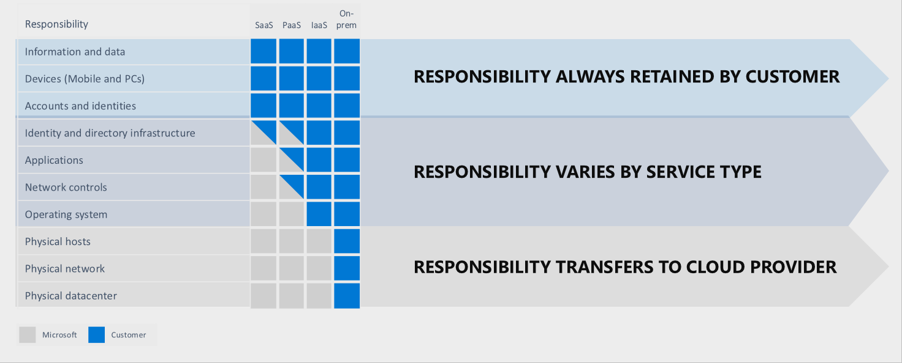
Azure Platform Shared Responsibility
Notes:
Headcount Increase
Additional resources to our BSA team to shorten lead times and scale when workload increases 8-17
Customer benefit – shorter lead times
Restructuring of team
CSA team will be restructured to be able to pick up tickets quicker – Put them in Zagreb
Added in strong manager to lead the team and join client facing updates
Customer benefit – increased responsiveness from team
Update internal processes
Removed all “non-support” responsibilities from the CSA team to Staffing Best Practices so that CSA team can focus on tickets and issues 5 year olds playing soccer
Putting better system in place for tracking and reporting to set KPI’s for teams
Faster escalation path to management and other teams
Customer benefit – escalations handled quicker, better quality of service, clarity and tracking on tickets
Close knowledge gaps
Created weekly internal learning plan
Knowlegde sharing sessions across teams
External Learning
Customer benefit – Removes risk and challenges of knowledge being restricted to key resources. Reduces wait/ lead times for questions

Slide 5
Azure Security Capabilities
Identity and access management | Azure Active Directory Azure Active Directory Identity Protection Azure Active Directory Domain Services Azure Active Directory B2C Azure Active Directory B2B Collaboration Azure Active Directory Devices Identity Azure Active Directory Application Proxy (SSO and secure remote access) Azure role-based access control (Azure RBAC) Multi-Factor Authentication Microsoft Authenticator Password policy enforcement Token-based authentication Integrated identity management (hybrid identity)
Notes:
Headcount Increase
Additional resources to our BSA team to shorten lead times and scale when workload increases 8-17
Customer benefit – shorter lead times
Restructuring of team
CSA team will be restructured to be able to pick up tickets quicker – Put them in Zagreb
Added in strong manager to lead the team and join client facing updates
Customer benefit – increased responsiveness from team
Update internal processes
Removed all “non-support” responsibilities from the CSA team to Staffing Best Practices so that CSA team can focus on tickets and issues 5 year olds playing soccer
Putting better system in place for tracking and reporting to set KPI’s for teams
Faster escalation path to management and other teams
Customer benefit – escalations handled quicker, better quality of service, clarity and tracking on tickets
Close knowledge gaps
Created weekly internal learning plan
Knowlegde sharing sessions across teams
External Learning
Customer benefit – Removes risk and challenges of knowledge being restricted to key resources. Reduces wait/ lead times for questions

Slide 6
Azure Security Capabilities
Operations | Azure Security Center Azure Resource Manager Application Insights Azure Monitor Azure Monitor logs Azure Advisor
Applications | Web Application vulnerability scanning Penetration Testing Web Application firewall Authentication and authorization in Azure App Service Layered Security Architecture Web server diagnostics and application diagnostics
Notes:
Headcount Increase
Additional resources to our BSA team to shorten lead times and scale when workload increases 8-17
Customer benefit – shorter lead times
Restructuring of team
CSA team will be restructured to be able to pick up tickets quicker – Put them in Zagreb
Added in strong manager to lead the team and join client facing updates
Customer benefit – increased responsiveness from team
Update internal processes
Removed all “non-support” responsibilities from the CSA team to Staffing Best Practices so that CSA team can focus on tickets and issues 5 year olds playing soccer
Putting better system in place for tracking and reporting to set KPI’s for teams
Faster escalation path to management and other teams
Customer benefit – escalations handled quicker, better quality of service, clarity and tracking on tickets
Close knowledge gaps
Created weekly internal learning plan
Knowlegde sharing sessions across teams
External Learning
Customer benefit – Removes risk and challenges of knowledge being restricted to key resources. Reduces wait/ lead times for questions

Slide 7
Azure Security Capabilities
Networking | Azure Virtual Network Network Layer Controls Network Security Groups Route Control Forced Tunneling Virtual Network Security Appliances Azure Private Link VPN Gateway Express Route Azure Load Balancer Application Gateway Web Application Firewall Traffic Manager Azure DNS Network Watcher
Notes:
Headcount Increase
Additional resources to our BSA team to shorten lead times and scale when workload increases 8-17
Customer benefit – shorter lead times
Restructuring of team
CSA team will be restructured to be able to pick up tickets quicker – Put them in Zagreb
Added in strong manager to lead the team and join client facing updates
Customer benefit – increased responsiveness from team
Update internal processes
Removed all “non-support” responsibilities from the CSA team to Staffing Best Practices so that CSA team can focus on tickets and issues 5 year olds playing soccer
Putting better system in place for tracking and reporting to set KPI’s for teams
Faster escalation path to management and other teams
Customer benefit – escalations handled quicker, better quality of service, clarity and tracking on tickets
Close knowledge gaps
Created weekly internal learning plan
Knowlegde sharing sessions across teams
External Learning
Customer benefit – Removes risk and challenges of knowledge being restricted to key resources. Reduces wait/ lead times for questions

Slide 8
Azure Security Capabilities
Storage | Azure role-based access control (Azure RBAC) Shared Access Signature Encryption in Transit Encryption at rest Storage Analytics Enabling Browser-Based Clients Using CORS (Cross-Origin Resource Sharing)
Compute | Antimalware & Antivirus Azure Key Vault Virtual machine backup Azure Site Recovery SQL VM Transparent data encryption (TDE) VM Disk Encryption Patch Updates Security policy management and reporting
Notes:
Headcount Increase
Additional resources to our BSA team to shorten lead times and scale when workload increases 8-17
Customer benefit – shorter lead times
Restructuring of team
CSA team will be restructured to be able to pick up tickets quicker – Put them in Zagreb
Added in strong manager to lead the team and join client facing updates
Customer benefit – increased responsiveness from team
Update internal processes
Removed all “non-support” responsibilities from the CSA team to Staffing Best Practices so that CSA team can focus on tickets and issues 5 year olds playing soccer
Putting better system in place for tracking and reporting to set KPI’s for teams
Faster escalation path to management and other teams
Customer benefit – escalations handled quicker, better quality of service, clarity and tracking on tickets
Close knowledge gaps
Created weekly internal learning plan
Knowlegde sharing sessions across teams
External Learning
Customer benefit – Removes risk and challenges of knowledge being restricted to key resources. Reduces wait/ lead times for questions

Slide 9
Compliance in Azure
European Banking Authority (EBA)
The Microsoft guidance addresses each of the EBA recommendations:
Audit rights. Microsoft provides contractual audit rights for customers and rights of examination for regulators in its industry-leading Financial Services Amendment.
Notification regarding outsourcing. Microsoft can assist customers with notifying regulators of material activities to be outsourced.
Data residency. With 36 regions, including six in Europe, Microsoft offers the largest number of datacenters worldwide of any cloud service provider. Organizations can deploy workloads in one region without being required to host data in Europe.
Notification regarding subcontractors. Microsoft leads the industry with a contractual commitment to provide customers with 180-day notice of new subcontractors, and a right to terminate if the customer does not approve of the appointment of a new subcontractor.
Business continuity. Microsoft provides business continuity and resolution provisions in our Financial Services Amendment, including the willingness to provide transition assistance through Microsoft Consulting Services.
Risk assessment and security monitoring. Microsoft enables customers to conduct their own risk assessments and provides tools and dashboards so they can supervise and monitor our cloud services.
https://docs.microsoft.com/en-us/compliance/regulatory/offering-eba-eu
Notes:
Headcount Increase
Additional resources to our BSA team to shorten lead times and scale when workload increases 8-17
Customer benefit – shorter lead times
Restructuring of team
CSA team will be restructured to be able to pick up tickets quicker – Put them in Zagreb
Added in strong manager to lead the team and join client facing updates
Customer benefit – increased responsiveness from team
Update internal processes
Removed all “non-support” responsibilities from the CSA team to Staffing Best Practices so that CSA team can focus on tickets and issues 5 year olds playing soccer
Putting better system in place for tracking and reporting to set KPI’s for teams
Faster escalation path to management and other teams
Customer benefit – escalations handled quicker, better quality of service, clarity and tracking on tickets
Close knowledge gaps
Created weekly internal learning plan
Knowlegde sharing sessions across teams
External Learning
Customer benefit – Removes risk and challenges of knowledge being restricted to key resources. Reduces wait/ lead times for questions

Slide 10
Compliance in Azure
The Payment Card Industry Data Security Standards (PCI DSS)
Azure PCI DSS Shared Responsibility Matrix specifies areas of responsibility for each PCI DSS requirement, and whether it is assigned to Azure or the customer, or if the responsibility is shared.
Azure Blueprints is a service that helps customers deploy and update cloud environments in a repeatable manner using composable artifacts such as Azure Resource Manager templates to provision resources, role-based access controls, and policies. Resources provisioned through Azure Blueprints adhere to an organization’s standards, patterns, and compliance requirements. The overarching goal of Azure Blueprints is to help automate compliance and cybersecurity risk management in cloud environments. To help customers deploy a core set of policies for any Azure-based architecture that requires PCI DSS validation, Azure has released the Azure Blueprint for PCI DSS. When assigned to an architecture, resources are evaluated by Azure Policy for compliance with assigned policy definitions.
https://docs.microsoft.com/en-us/azure/compliance/offerings/offering-pci-dss
Notes:
Headcount Increase
Additional resources to our BSA team to shorten lead times and scale when workload increases 8-17
Customer benefit – shorter lead times
Restructuring of team
CSA team will be restructured to be able to pick up tickets quicker – Put them in Zagreb
Added in strong manager to lead the team and join client facing updates
Customer benefit – increased responsiveness from team
Update internal processes
Removed all “non-support” responsibilities from the CSA team to Staffing Best Practices so that CSA team can focus on tickets and issues 5 year olds playing soccer
Putting better system in place for tracking and reporting to set KPI’s for teams
Faster escalation path to management and other teams
Customer benefit – escalations handled quicker, better quality of service, clarity and tracking on tickets
Close knowledge gaps
Created weekly internal learning plan
Knowlegde sharing sessions across teams
External Learning
Customer benefit – Removes risk and challenges of knowledge being restricted to key resources. Reduces wait/ lead times for questions

Slide 11
Compliance in Azure
General Data Protection Regulation (GDPR)
Microsoft provides customers with strong contractual commitments regarding the GDPR in the Microsoft Online Services Terms (OST) Data Protection Addendum (DPA). Moreover, Microsoft provides extensive tools and documentation to support customer’s GDPR accountability including support for Data Subject Requests, Data Protection Impact Assessments, and Data Breach Notification.
https://docs.microsoft.com/en-us/azure/compliance/offerings/offering-eu-gdpr
Accessibility requirements suitable for public procurement of information and communications technologies (ICT) products and services (EU EN 301 549)
To assist government customers in making procurement decisions, Microsoft publishes Accessibility Conformance Reports (ACRs) describing the extent to which our products and services support the criteria of EN 301 549.
https://docs.microsoft.com/en-us/azure/compliance/offerings/offering-eu-en-301-549
Notes:
Headcount Increase
Additional resources to our BSA team to shorten lead times and scale when workload increases 8-17
Customer benefit – shorter lead times
Restructuring of team
CSA team will be restructured to be able to pick up tickets quicker – Put them in Zagreb
Added in strong manager to lead the team and join client facing updates
Customer benefit – increased responsiveness from team
Update internal processes
Removed all “non-support” responsibilities from the CSA team to Staffing Best Practices so that CSA team can focus on tickets and issues 5 year olds playing soccer
Putting better system in place for tracking and reporting to set KPI’s for teams
Faster escalation path to management and other teams
Customer benefit – escalations handled quicker, better quality of service, clarity and tracking on tickets
Close knowledge gaps
Created weekly internal learning plan
Knowlegde sharing sessions across teams
External Learning
Customer benefit – Removes risk and challenges of knowledge being restricted to key resources. Reduces wait/ lead times for questions

Slide 12
Application Migration Procedure
Migration Procedure | Migration Details
1. Deploy the Cloud Environment. | Provision, install and test the necessary storage, compute, network and security resources that constitute the cloud environment in which the migrated application will run.
2. Implement Monitoring and Management Services and Components. | Set up the organization, processes, procedures, and tools that will be used to manage and monitor the environment.
3. Install and Configure the Applications and supporting middleware. | Cloud service providers frequently do this through automated deployment of templates.
4. Harden the Production Environment | Install additional utilities for business continuity and security. Some of these services may be provided by the cloud service provider, in which case they do not need to be installed, but they should still be tested.
Notes:
Headcount Increase
Additional resources to our BSA team to shorten lead times and scale when workload increases 8-17
Customer benefit – shorter lead times
Restructuring of team
CSA team will be restructured to be able to pick up tickets quicker – Put them in Zagreb
Added in strong manager to lead the team and join client facing updates
Customer benefit – increased responsiveness from team
Update internal processes
Removed all “non-support” responsibilities from the CSA team to Staffing Best Practices so that CSA team can focus on tickets and issues 5 year olds playing soccer
Putting better system in place for tracking and reporting to set KPI’s for teams
Faster escalation path to management and other teams
Customer benefit – escalations handled quicker, better quality of service, clarity and tracking on tickets
Close knowledge gaps
Created weekly internal learning plan
Knowlegde sharing sessions across teams
External Learning
Customer benefit – Removes risk and challenges of knowledge being restricted to key resources. Reduces wait/ lead times for questions

Slide 13
Application Migration Procedure
Migration Procedure | Migration Details
5. Execute a Mock Migration. | Undergo a trial run of the migration project plan to uncover unintended results or unnoticed issues during the planning phase. The mock migration date should be sufficiently distant from the desired final cutover date to have time to rectify problems. Involve the cloud service provider in the migration date selection.
6. Execute operational readiness testing. | This will help ensure that the operations team, processes, and tools are ready.
7. Cutover to Production Cloud. | Assuming a successful mock migration, or one that only encountered minor issues with a clear fix, establish a formal cutover schedule. If the mock migration ran into serious issues, then it needs to be repeated after correcting the causes.
Notes:
Headcount Increase
Additional resources to our BSA team to shorten lead times and scale when workload increases 8-17
Customer benefit – shorter lead times
Restructuring of team
CSA team will be restructured to be able to pick up tickets quicker – Put them in Zagreb
Added in strong manager to lead the team and join client facing updates
Customer benefit – increased responsiveness from team
Update internal processes
Removed all “non-support” responsibilities from the CSA team to Staffing Best Practices so that CSA team can focus on tickets and issues 5 year olds playing soccer
Putting better system in place for tracking and reporting to set KPI’s for teams
Faster escalation path to management and other teams
Customer benefit – escalations handled quicker, better quality of service, clarity and tracking on tickets
Close knowledge gaps
Created weekly internal learning plan
Knowlegde sharing sessions across teams
External Learning
Customer benefit – Removes risk and challenges of knowledge being restricted to key resources. Reduces wait/ lead times for questions

Slide 14
Questions need to be clarified
What are the CPU architecture and model used by application servers?
How many CPU are used by Oracle database server? What are the CPU architecture and model?
What is throughput of shared disk system in IOPS?
What is the volume of each disk of each server?
Are application servers and Oracle database server bare metal servers or VMs? Which Private Cloud is used in case of VMs?
What volume of network traffic is used by application daily/weekly/monthly? Are there any spikes/surges? During which days/hours?
What device(s) is used for routing/VPN(s)? Is there any ability to establish additional VPN and/or dedicated channel?
Does client’s Internet provider has ability to establish dedicated channel?
What operation systems are installed on application servers? Oracle database server?
Which Oracle Database Edition is used? Enterprise or Standard? What is release version?
Which .Net Framework version is used?
Is there in place any orchestration/management system?
Notes:
Headcount Increase
Additional resources to our BSA team to shorten lead times and scale when workload increases 8-17
Customer benefit – shorter lead times
Restructuring of team
CSA team will be restructured to be able to pick up tickets quicker – Put them in Zagreb
Added in strong manager to lead the team and join client facing updates
Customer benefit – increased responsiveness from team
Update internal processes
Removed all “non-support” responsibilities from the CSA team to Staffing Best Practices so that CSA team can focus on tickets and issues 5 year olds playing soccer
Putting better system in place for tracking and reporting to set KPI’s for teams
Faster escalation path to management and other teams
Customer benefit – escalations handled quicker, better quality of service, clarity and tracking on tickets
Close knowledge gaps
Created weekly internal learning plan
Knowlegde sharing sessions across teams
External Learning
Customer benefit – Removes risk and challenges of knowledge being restricted to key resources. Reduces wait/ lead times for questions

Slide 15
Questions need to be clarified
Is application configured as monolith or a bunch of microservices?
Does application have any tiers? i.e. web, database, etc? Is traffic between tiers encrypted?
Are all application servers configured identically? i.e. all Application servers are replicas and Network Load Balancer is used or each of Application servers is hosting separate parts of application?
Who is responsible for building and deploying the application? Which building/deploying tools are used(if any)?
Does client have access to application code sources? What repository is used (if any)?
What system(s) is/are used for monitoring hardware, OS, application? Are client planning to proceed with them in cloud?
Have client any engineers who trained or have experience to work with clouds? For which cloud(s)?
What facilities are used for application hardening? Antiviruses/antimalware?
Notes:
Headcount Increase
Additional resources to our BSA team to shorten lead times and scale when workload increases 8-17
Customer benefit – shorter lead times
Restructuring of team
CSA team will be restructured to be able to pick up tickets quicker – Put them in Zagreb
Added in strong manager to lead the team and join client facing updates
Customer benefit – increased responsiveness from team
Update internal processes
Removed all “non-support” responsibilities from the CSA team to Staffing Best Practices so that CSA team can focus on tickets and issues 5 year olds playing soccer
Putting better system in place for tracking and reporting to set KPI’s for teams
Faster escalation path to management and other teams
Customer benefit – escalations handled quicker, better quality of service, clarity and tracking on tickets
Close knowledge gaps
Created weekly internal learning plan
Knowlegde sharing sessions across teams
External Learning
Customer benefit – Removes risk and challenges of knowledge being restricted to key resources. Reduces wait/ lead times for questions

Slide 16
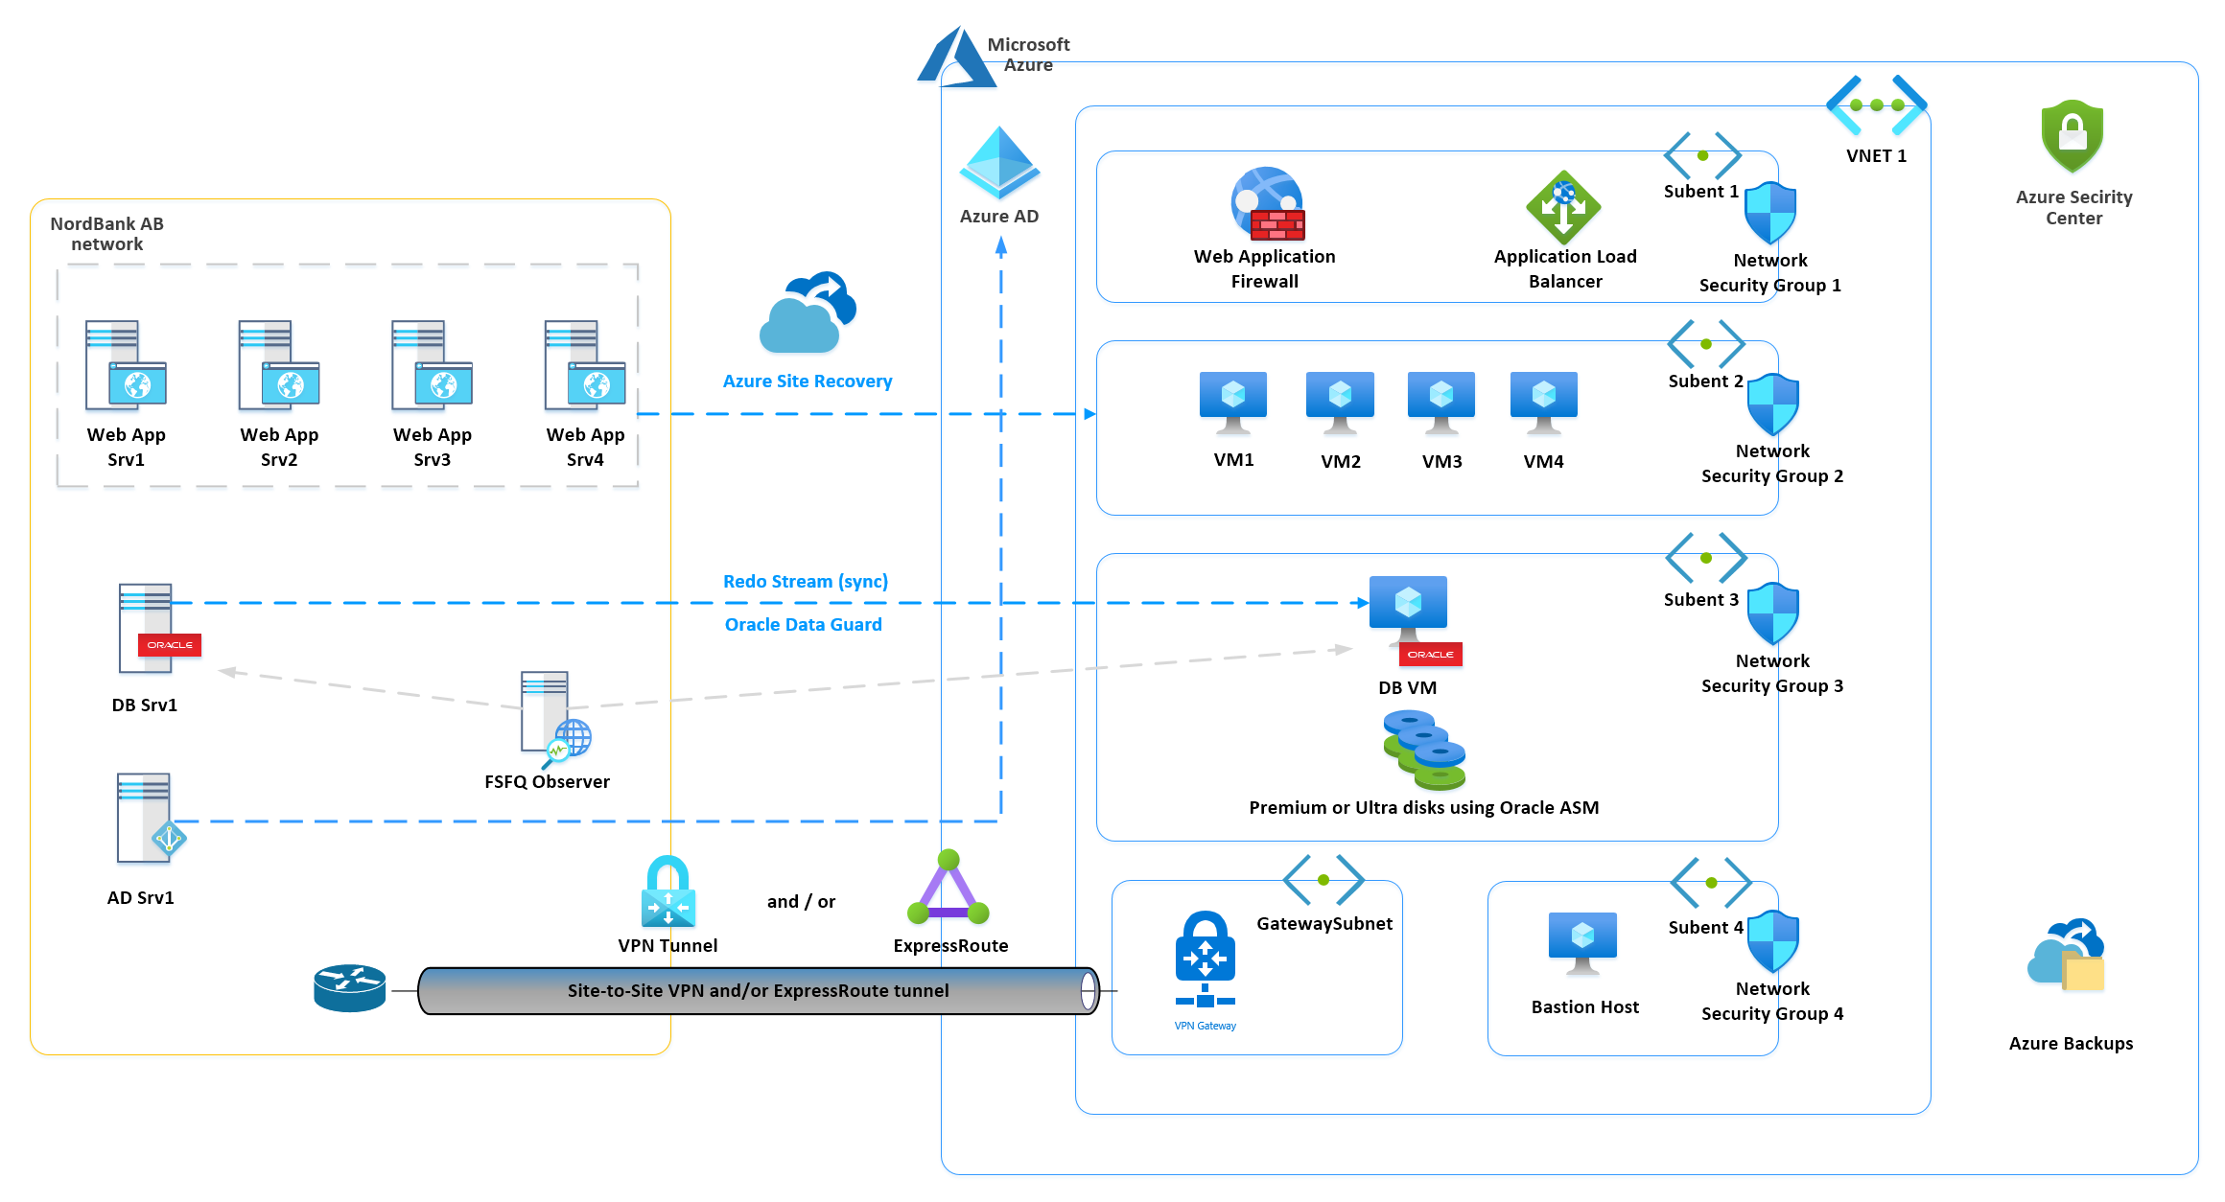
“Lift and shift” migration with MS Active Directory and Site Recovery
Notes:
Headcount Increase
Additional resources to our BSA team to shorten lead times and scale when workload increases 8-17
Customer benefit – shorter lead times
Restructuring of team
CSA team will be restructured to be able to pick up tickets quicker – Put them in Zagreb
Added in strong manager to lead the team and join client facing updates
Customer benefit – increased responsiveness from team
Update internal processes
Removed all “non-support” responsibilities from the CSA team to Staffing Best Practices so that CSA team can focus on tickets and issues 5 year olds playing soccer
Putting better system in place for tracking and reporting to set KPI’s for teams
Faster escalation path to management and other teams
Customer benefit – escalations handled quicker, better quality of service, clarity and tracking on tickets
Close knowledge gaps
Created weekly internal learning plan
Knowlegde sharing sessions across teams
External Learning
Customer benefit – Removes risk and challenges of knowledge being restricted to key resources. Reduces wait/ lead times for questions

Slide 17
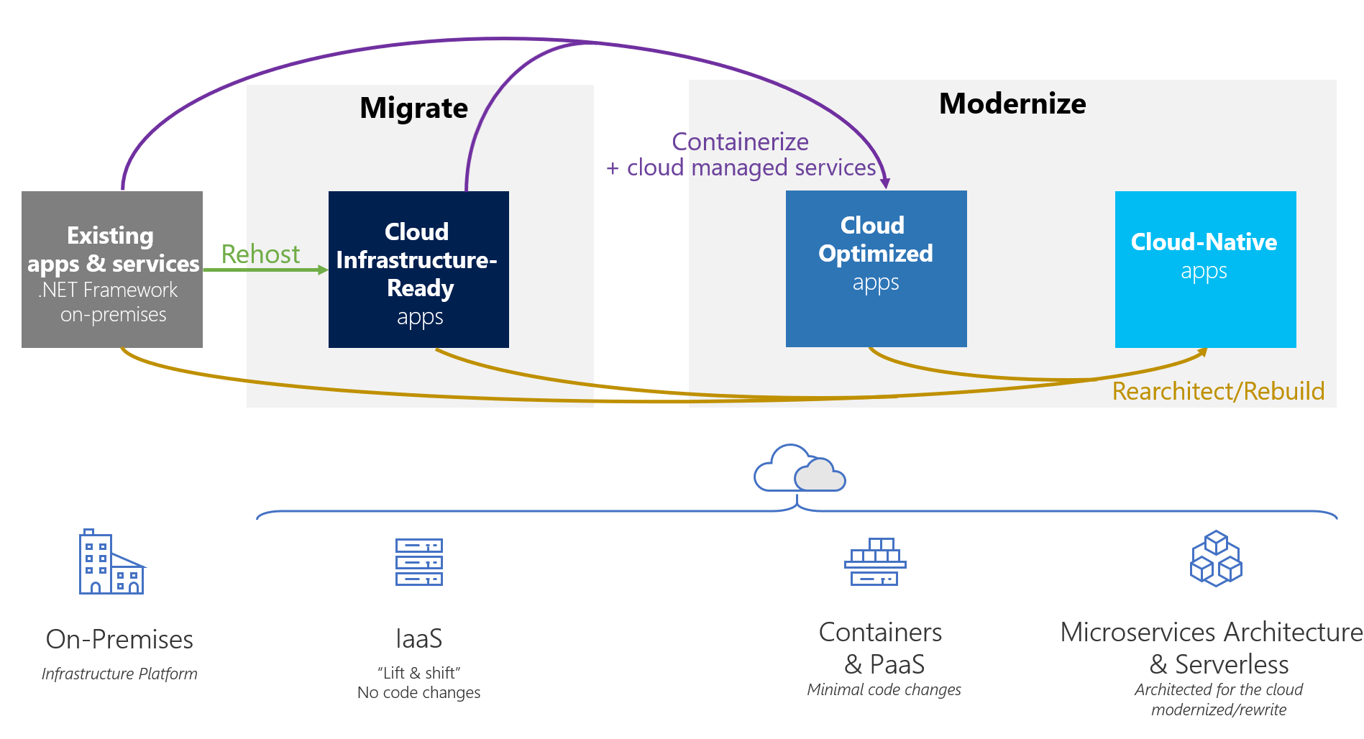
Path to the cloud for existing .NET application
Notes:
Headcount Increase
Additional resources to our BSA team to shorten lead times and scale when workload increases 8-17
Customer benefit – shorter lead times
Restructuring of team
CSA team will be restructured to be able to pick up tickets quicker – Put them in Zagreb
Added in strong manager to lead the team and join client facing updates
Customer benefit – increased responsiveness from team
Update internal processes
Removed all “non-support” responsibilities from the CSA team to Staffing Best Practices so that CSA team can focus on tickets and issues 5 year olds playing soccer
Putting better system in place for tracking and reporting to set KPI’s for teams
Faster escalation path to management and other teams
Customer benefit – escalations handled quicker, better quality of service, clarity and tracking on tickets
Close knowledge gaps
Created weekly internal learning plan
Knowlegde sharing sessions across teams
External Learning
Customer benefit – Removes risk and challenges of knowledge being restricted to key resources. Reduces wait/ lead times for questions

Slide 18
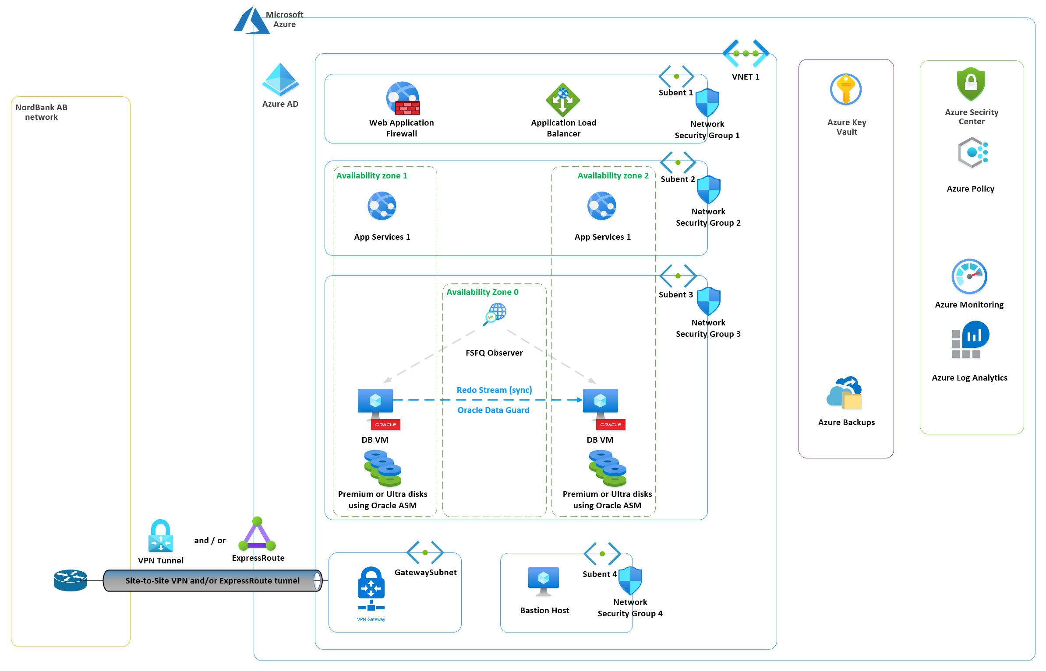
Cloud-optimizing configuration – Azure monitoring, hardening and high-availability implementation
Notes:
Headcount Increase
Additional resources to our BSA team to shorten lead times and scale when workload increases 8-17
Customer benefit – shorter lead times
Restructuring of team
CSA team will be restructured to be able to pick up tickets quicker – Put them in Zagreb
Added in strong manager to lead the team and join client facing updates
Customer benefit – increased responsiveness from team
Update internal processes
Removed all “non-support” responsibilities from the CSA team to Staffing Best Practices so that CSA team can focus on tickets and issues 5 year olds playing soccer
Putting better system in place for tracking and reporting to set KPI’s for teams
Faster escalation path to management and other teams
Customer benefit – escalations handled quicker, better quality of service, clarity and tracking on tickets
Close knowledge gaps
Created weekly internal learning plan
Knowlegde sharing sessions across teams
External Learning
Customer benefit – Removes risk and challenges of knowledge being restricted to key resources. Reduces wait/ lead times for questions

Slide 19
Thank You

